Slide 1
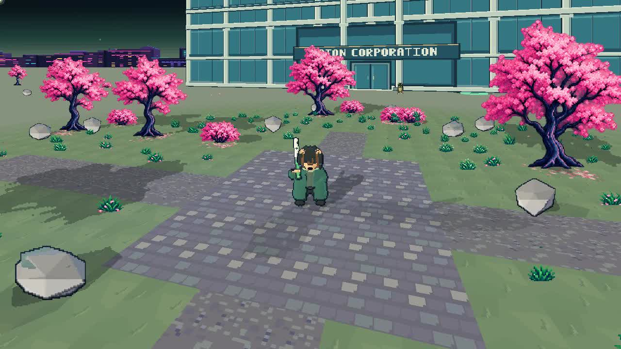
SOLANA MOBILE HACKATHON
Seekerbound
A shared fantasy action RPG
built for Seeker
Explore with friends. Fight and heal.
Collect gear and build your character.
Existing staged game capture
SEEKERBOUND / ANIDRAFT LIMITED
01
Notes:
Native Android source and existing game capture. Seekerbound is developed by AniDraft Limited. Image is a staged capture; it is not two-human multiplayer proof.

Slide 2
SOLANA MOBILE HACKATHON
The player loop
PLAY
PROGRESS
EXPRESS
Enter a shared world.
Fight enemies and use
skills with other players.
Earn loot through play.
Equip a loadout.
Return for new challenges.
Choose a character look.
Planned: SKR cosmetics
and eligible item trades.
Combat progression remains available through gameplay.
SEEKERBOUND / ANIDRAFT LIMITED
02
Notes:
Current source supports combat, equipment and connected gameplay. Progression cadence and economy policies below are proposed; player trading is not live.

Slide 3
SOLANA MOBILE HACKATHON
Solana Mobile integration
Native Kotlin Mobile Wallet Adapter
Open wallet → authorize → sign server challenge → verify session.
Separate approval for a purchase
Linked wallet → review transaction → sign and send → server confirms.
MWA is implemented. A completed SKR purchase still needs live proof.
SEEKERBOUND / ANIDRAFT LIMITED
03
Notes:
Source: GodotWalletPlugin.kt, WalletProof.kt, WalletLinkProof.kt, WalletTransaction.kt and wallet_account_v1.gd. Official reference https://github.com/solana-mobile/mobile-wallet-adapter/blob/main/android/docs/integration_guide.md. Real SKR settlement and gameplay grant remain unfinished; this is the intended purchase sequence.

Slide 4
SOLANA MOBILE HACKATHON
How the world connects
ANDROID
SERVER
DESKTOP
Godot game + assets
Kotlin wallet bridge
Secure session storage
Authenticated API
Shared world authority
Inventory and combat
Godot web companion
Same account services
Same shared world
Wallet signatures prove identity; the server owns gameplay state.
SEEKERBOUND / ANIDRAFT LIMITED
04
Notes:
Source: current Godot client, native Kotlin plugins, server-demo-party-v1/worker-candidate-v1.mjs and equipment-healing-v1/authority-v1.js. Native wallet origin is seekerbound.shawnli.dev. Web has email sign-in. Architecture is source-backed; a code diagram alone does not verify a live session.

Slide 5
SOLANA MOBILE HACKATHON
Working state and proof
IMPLEMENTED
STILL TO VERIFY / SHIP
Native Android build 0.207.0
Combat, equipment and healing
Shared gameplay services
MWA login, linking and approval
Real SKR purchase + receipt
Seeker + desktop live recording
Marketplace settlement
Guild and event systems
The existing 2:53 demo includes staged scenes.
SEEKERBOUND / ANIDRAFT LIMITED
05
Notes:
Source: current workspace SESSION_CONTEXT.md and hackathon-site SESSION_CONTEXT.md. Signed APK is downloadable; private GitHub source is still version206. No store approval, live SKR settlement or completed human multiplayer recording is claimed.

Slide 6
RETENTION DESIGN — PROPOSED
Why players return
DAILY: 5–10 MIN
WEEKLY: TOGETHER
LONGER TERM
Short combat objectives
Useful progression
Cosmetic collection
No paid streak recovery
Scheduled co-op bosses
Community challenges
Guild goals and roles
Shareable rare finds
Earn mastery and builds
Collect distinctive looks
Rotate content and events
Keep combat fair
SEEKERBOUND / ANIDRAFT LIMITED
06
Notes:
Proposed retention design, not implemented daily quests, live guilds or measured retention. Rarity must be transparent and must not imply investment returns.

Slide 7
SOLANA MOBILE HACKATHON
Playtest evidence and next test
Current evidence
Founder device testing and source checks; no measured retention cohort.
Next: a small Seeker playtest
Recruit 10–20 players; observe first quest, co-op join and return intent.
Track D1 / D7 return, quest completion, co-op sessions and player quotes.
SEEKERBOUND / ANIDRAFT LIMITED
07
Notes:
There are no supplied validated external-user quotes or D1/D7 metrics. Cohort size and metrics are a proposed validation plan. Do not label founder testing as user traction.

Slide 8
ECONOMY POLICY — PROPOSED
SKR utility without purchased power
GEAR & RARITY
SKR USE
FEES & FAIRNESS
Earn combat gear in play
Fair competitive stats
Trade cosmetics and
eligible collectibles
Fixed-price cosmetics
Optional visual upgrades
Transparent item trades
No paid combat power
Proposed 2% seller fee
Show total before approval
No paid drop-rate boosts
No paid energy or revives
SEEKERBOUND / ANIDRAFT LIMITED
08
Notes:
New proposed economy design for review, not deployed policy. Combat gear remains play-earned; cosmetics do not change stats. Competitive normalization, fees and eligible collectibles require implementation. Token mint confirmed at https://solanamobile.com/skr: SKRbvo6Gf7GondiT3BbTfuRDPqLWei4j2Qy2NPGZhW3. No token price, income or appreciation forecast.

Slide 9
ECONOMY POLICY — PROPOSED
Buybacks and safe trading
Capped buybacks; no guaranteed exit
Treasury-funded offers only for eligible cosmetics; pause when budget is spent.
Confirm payment before transferring an item
Quote locks item + price + fee; confirmed chain receipt settles once.
No combat gear buybacks at launch. No unlimited liquidity promise.
SEEKERBOUND / ANIDRAFT LIMITED
09
Notes:
Proposed constraints replace the earlier unspecified gear buyback direction. Require server-set eligibility, expiry, inventory reservation, idempotent receipts, replay prevention and reconciliation for failures after payment. A fixed percentage fee and buyback budget are not yet active.

Slide 10
SOLANA MOBILE HACKATHON
Verify the build
Install and inspect
downloads.anidraft.com/seekerbound-0.207.0.apk
Review source and watch the demo
seekerbound.anidraft.com/evidence/ · /demo/
Audit identifies source versions, checksums and incomplete evidence.
SEEKERBOUND / ANIDRAFT LIMITED
10
Notes:
Public audit is a curated source review bundle, not a full standalone rebuild. Existing private Android repository is version206 until updated. Current APK207 identity and authoritative server source are pinned separately. Demo remains the original staged2:53 video until live proof is captured.

